Slide 1
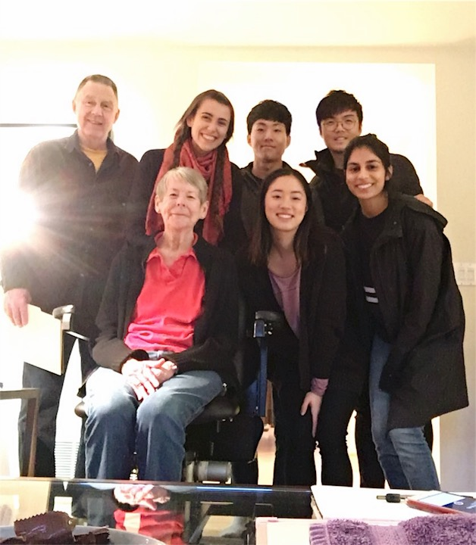
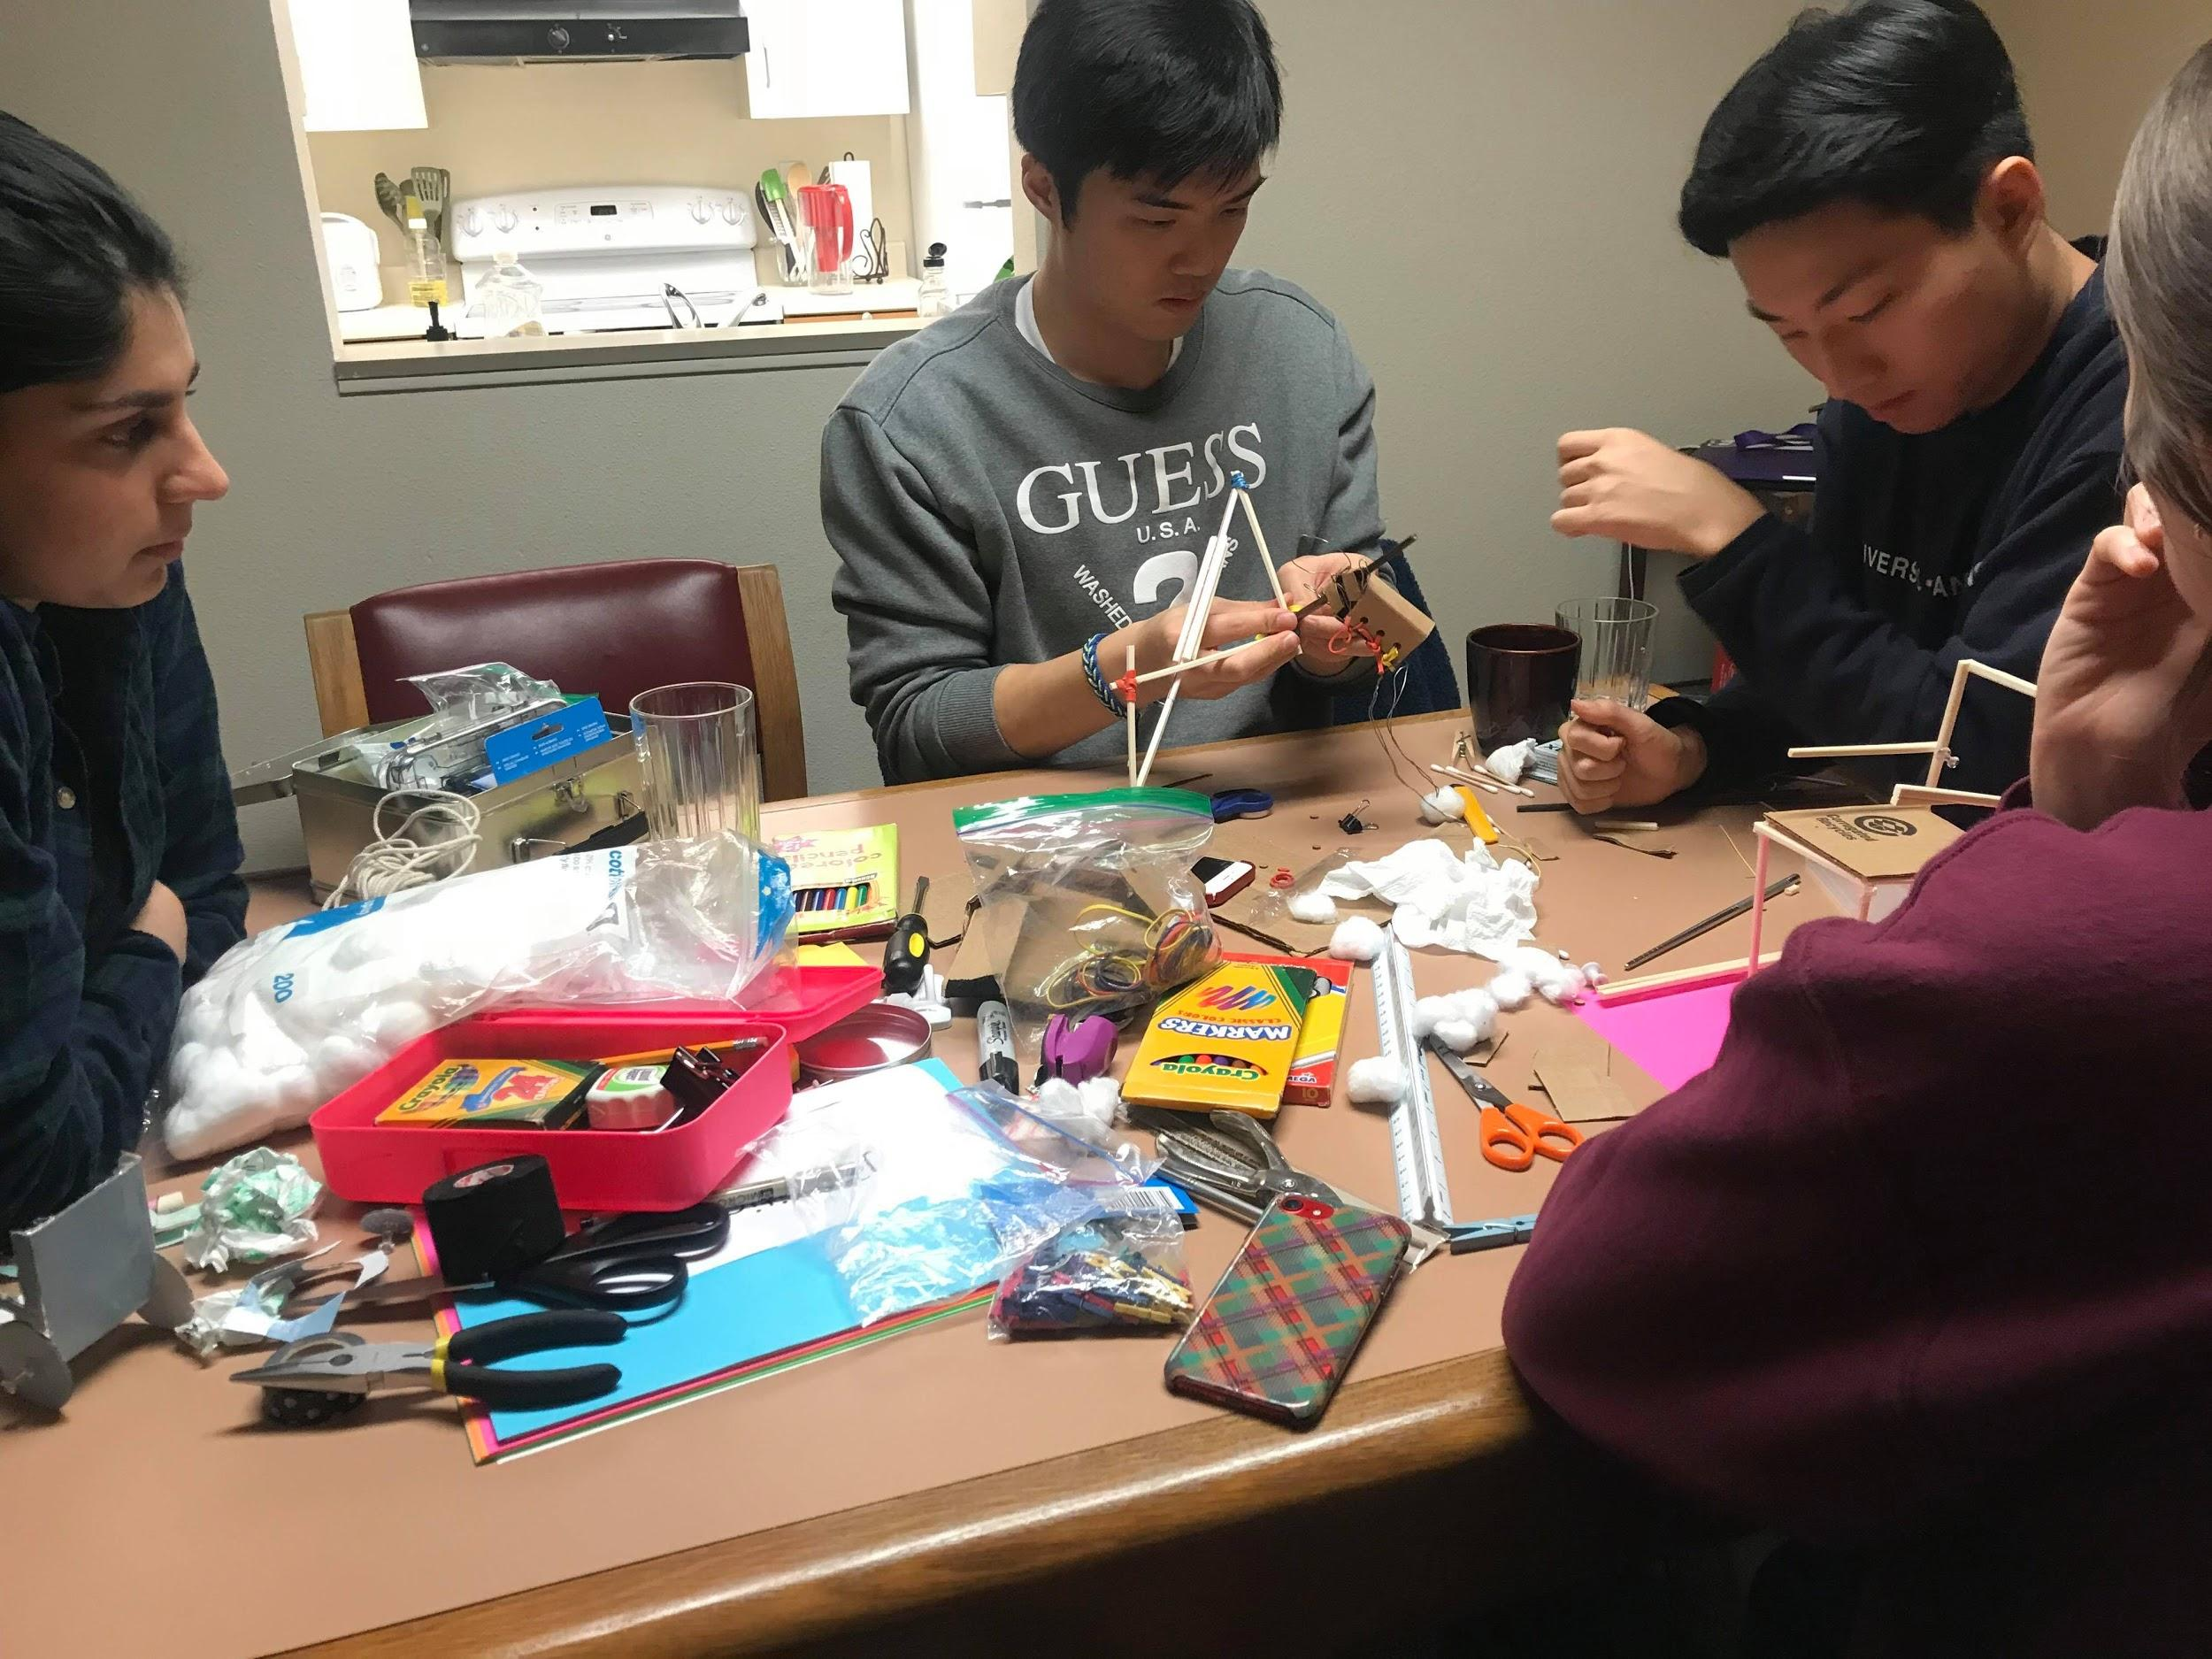
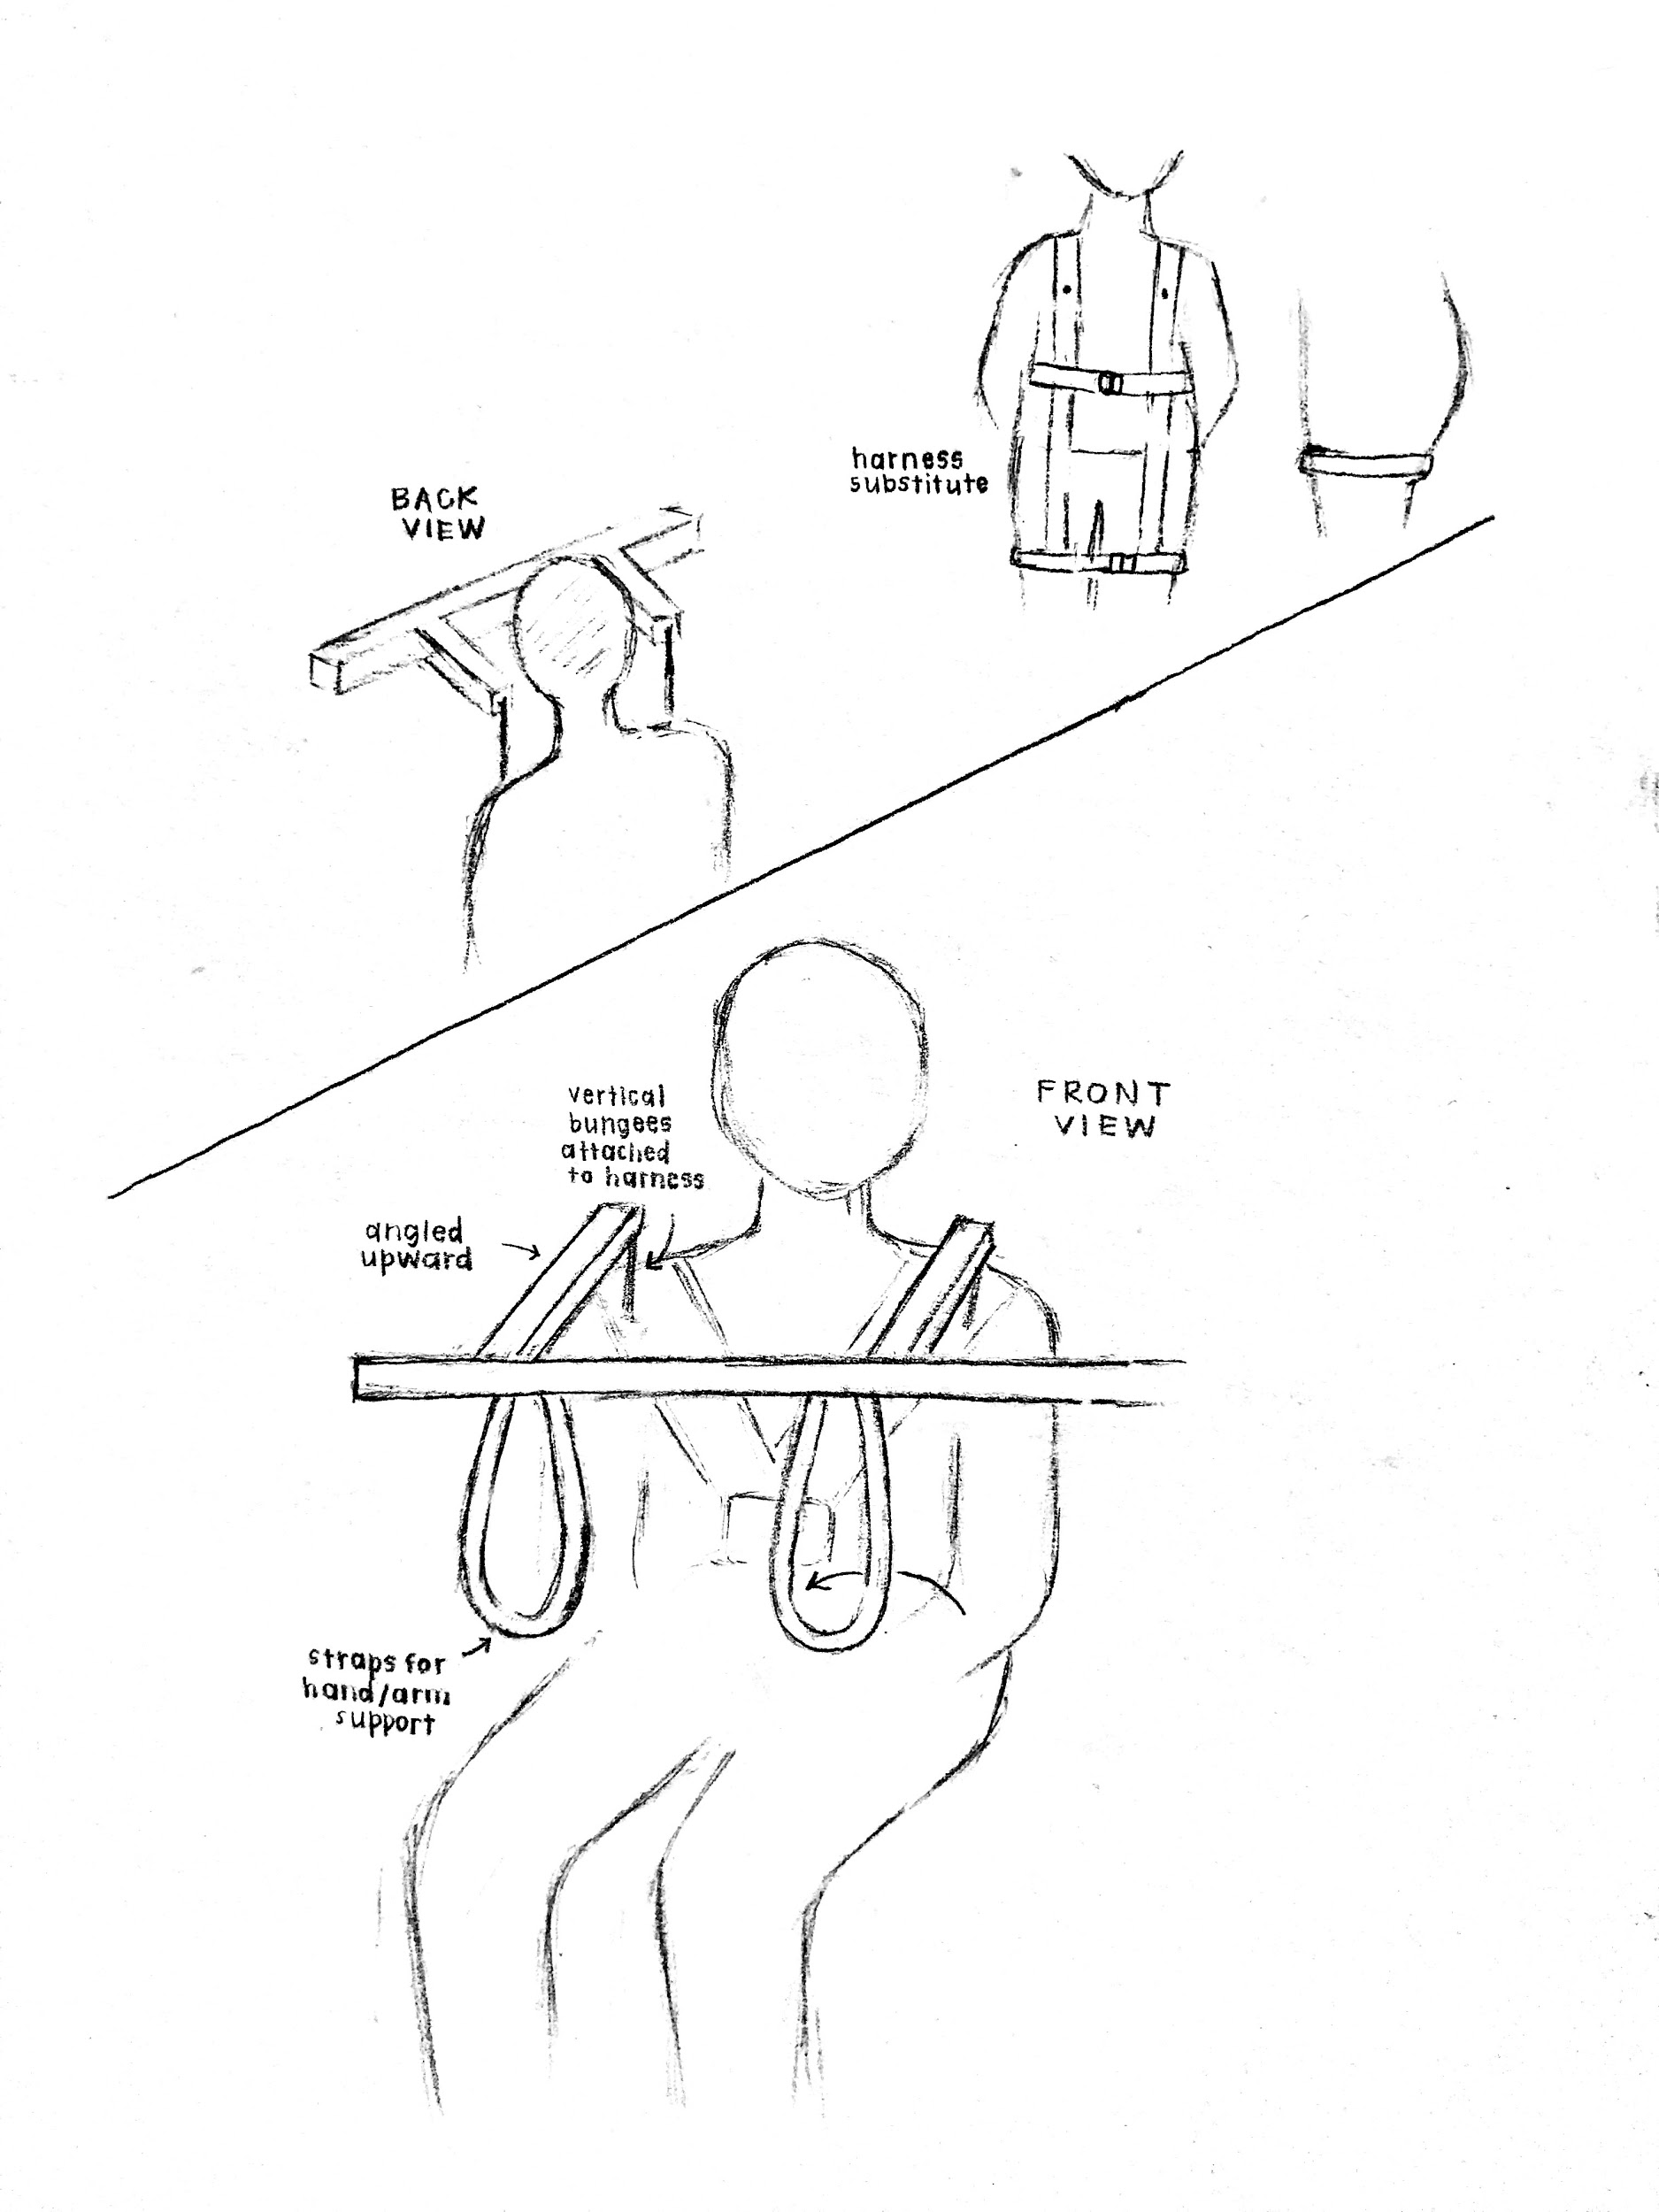
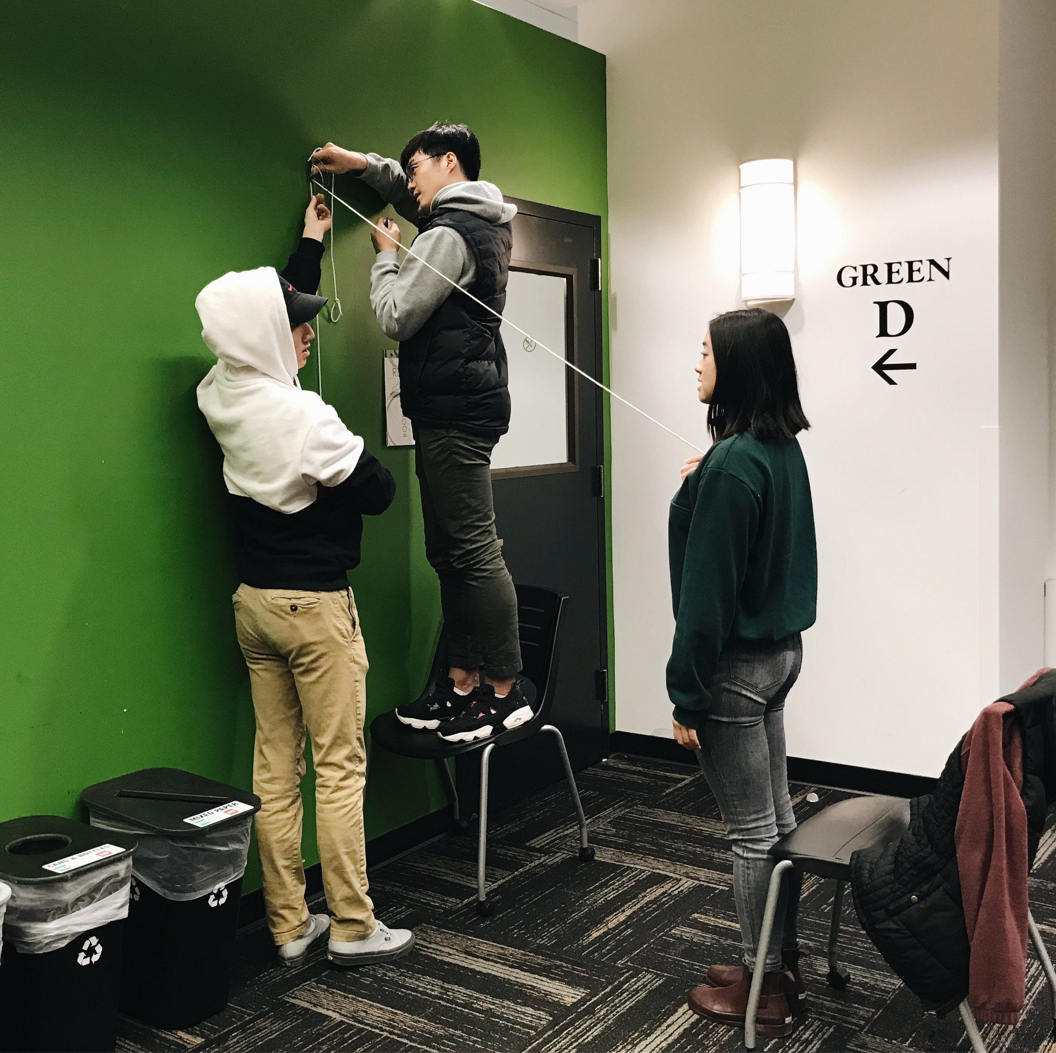
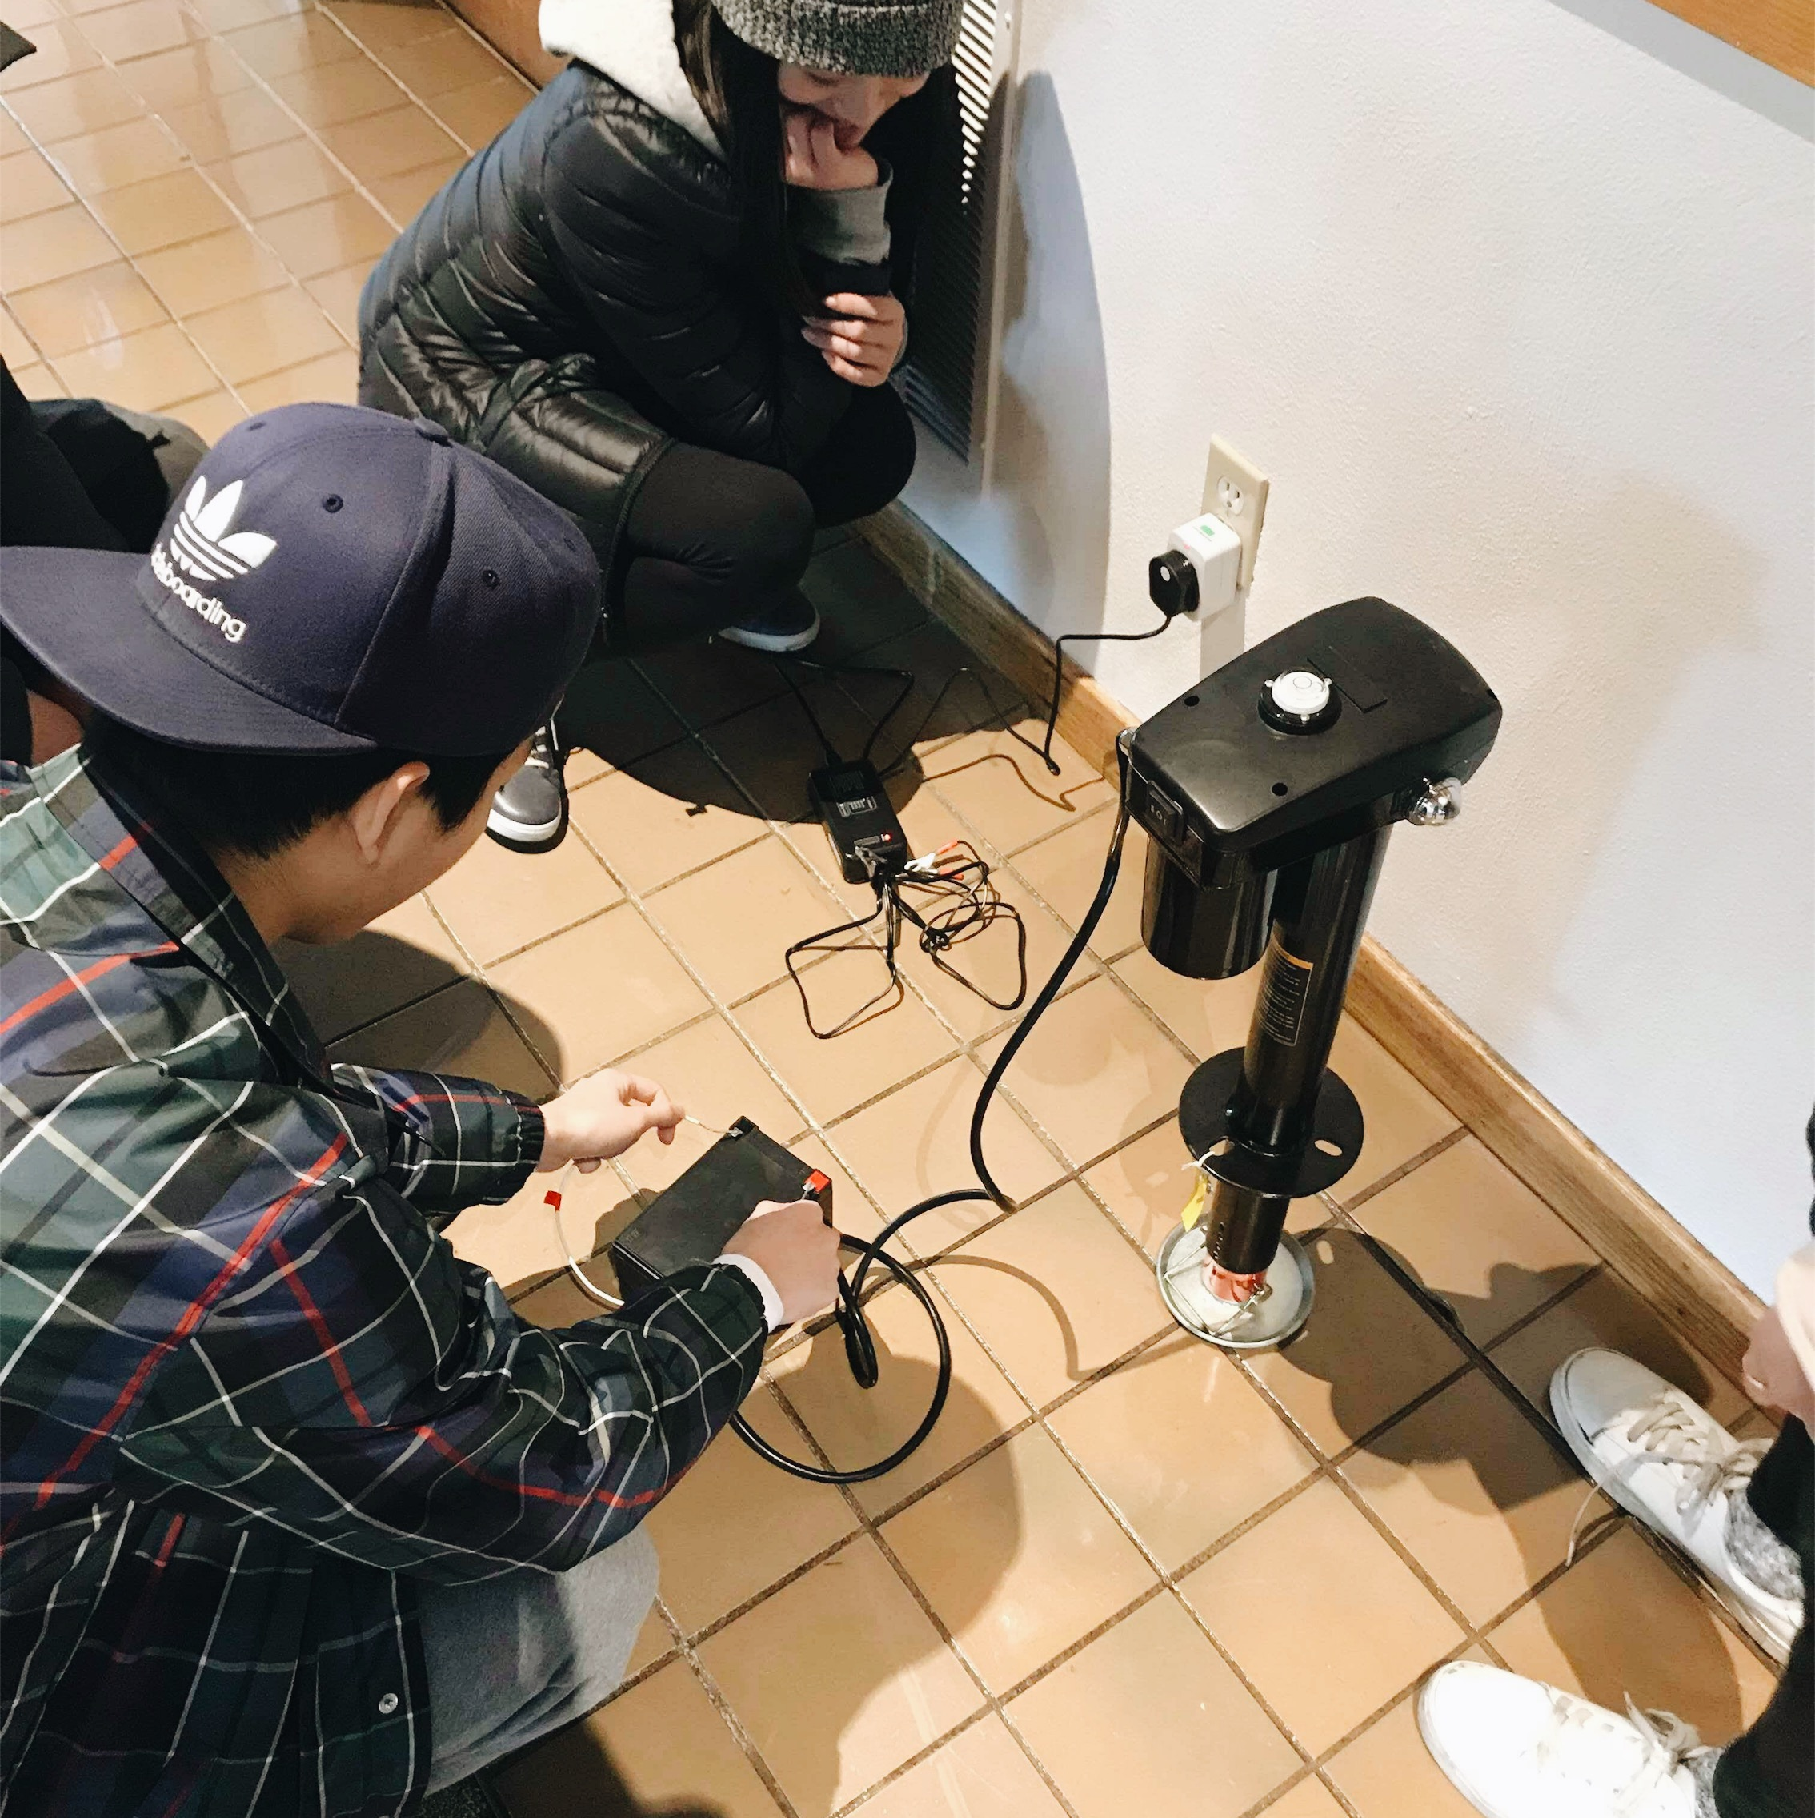
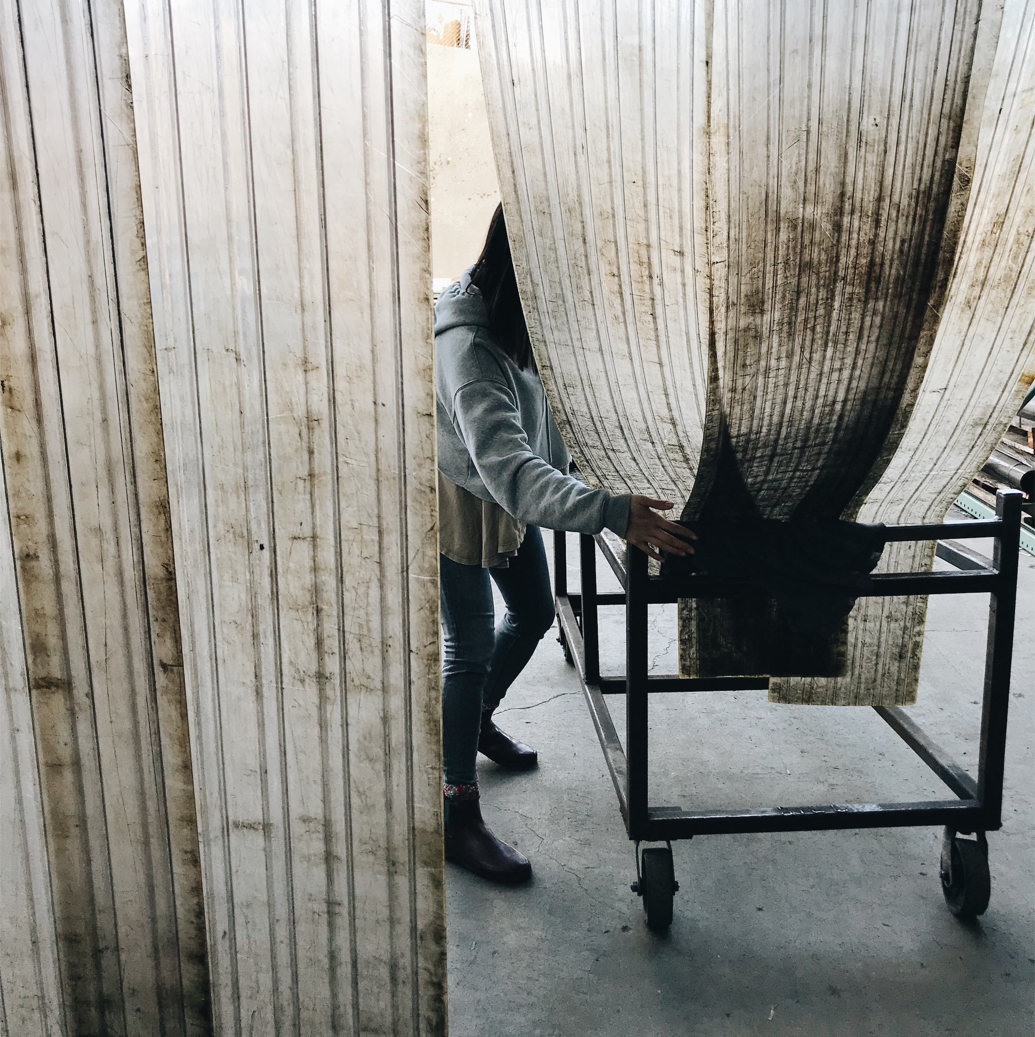
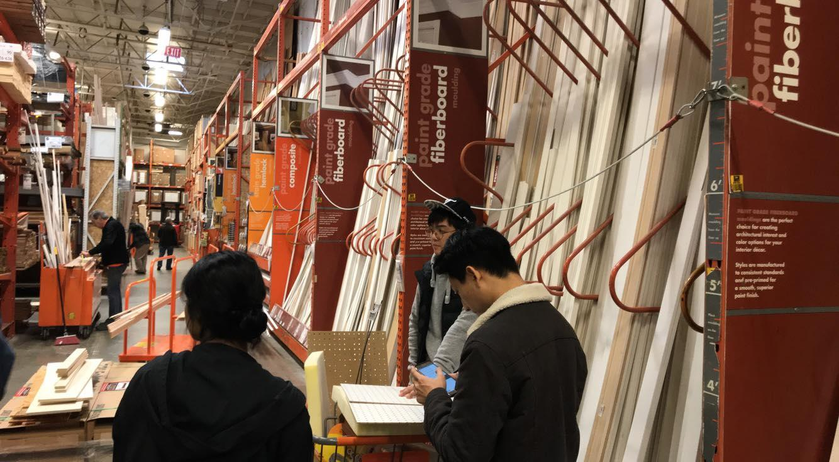
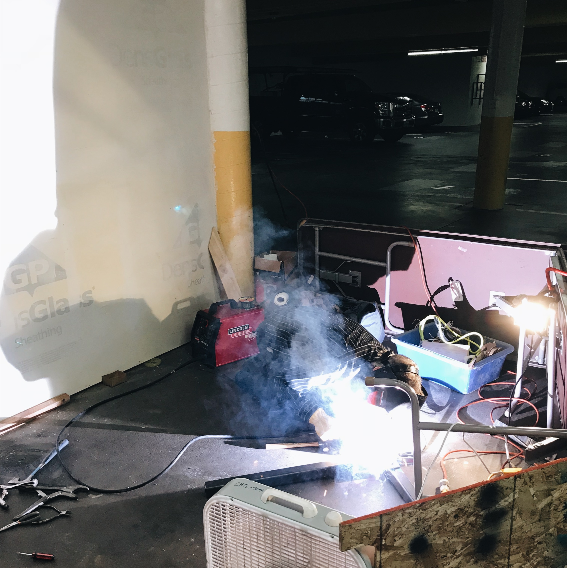
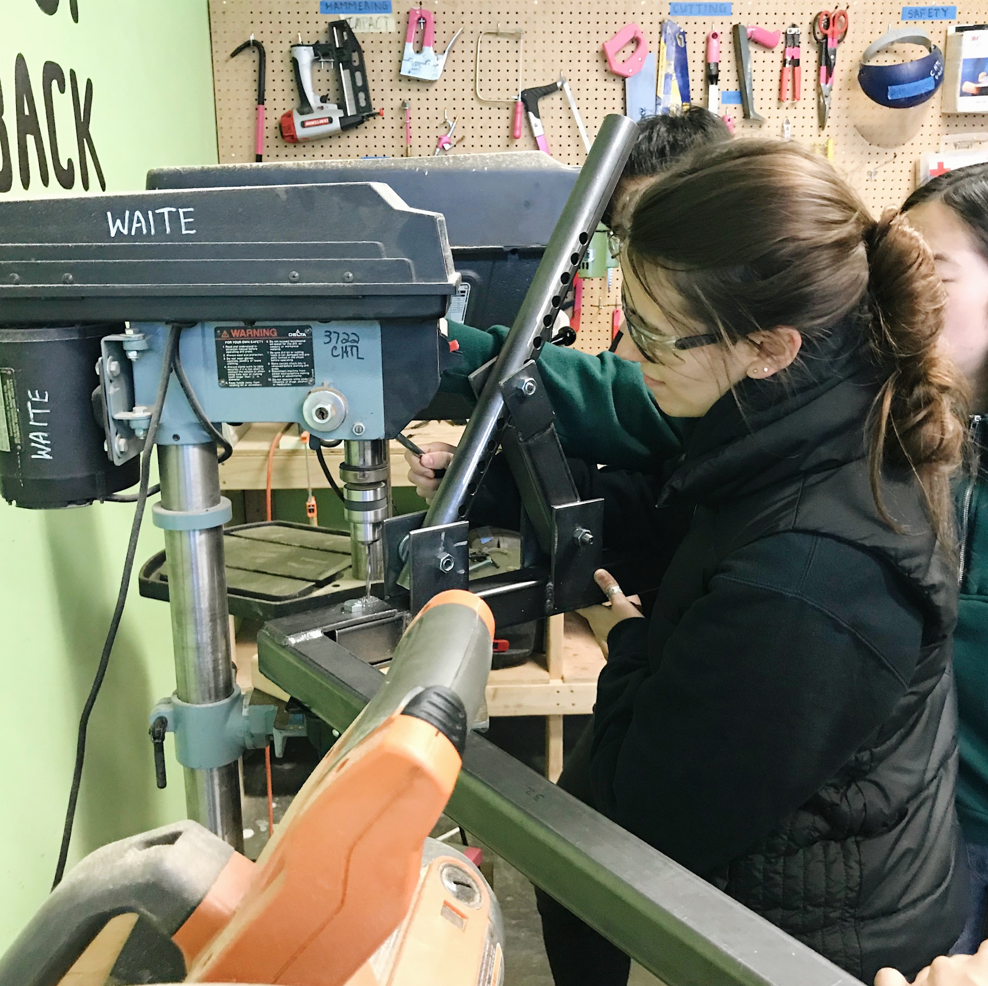
Team Transfer
Hyeongju Choi, Ritika Gupta, Jasmine Hawkins, Sharon Heung, Yoonbo Shim
Departments of Bioengineering, Human Centered Design and Engineering, Mechanical Engineering
The Challenge
“Jack” of All Transfers
Individuals with limited mobility often require assistance in safely transferring from standing to sitting and standing to sitting. We have created a tool that supports safer transfers, encouraging independence and empowerment.
“Jack” of All Transfers is a 3-component transfer tool comprised of a steel base, harness, and electric jack.
1. Steel Base
Angle adjustable for different chairs
Height adjustable for people of different heights
Easily transportable with lockable wheels and foldable parts
2. Electric Jack
Supports large range of human weights
Prevents side force
Moves slowly
3. Harness
Comfortable and secure
May not be practical for taking on and off
May feel obtrusive to wear
Ensures safety, above all
Reduces reliance on expensive devices and family support
Is transportable, comfortable, and easy to use
Enables transfers from chairs, beds, toilets, and cars
Timeline Winter Quarter 2018
Build a prototype - Linear Acturator
Week 1
~
Week 2
Finalizing our device dimensions | Ordered materials
2
Week 3
~
Week 4
3
Buying supplies at Pacific Industrial & Home Depot
Week 5
~
Week 6
1
Welding and drilling at Capitol Hill Tool Library
Future Plans
Week 7
~
Week 9
Make our design more lightweight and compact
Conduct more usability tests
Improve the efficiency and speed of our device
Understand the scope of our tool’s functions
Implement remote-controlled function for independent use
Acknowledgements
Thank you to Carolee and Tom Mathers, George Zatloka, Dr. Kat M. Steele, Dr. Heather Feldner, Dr. Dianne Hendricks, Dr. Anat Caspi, and the Capitol Hill Tool Library for your help and cooperation! We also thank the Mathers Fund to Empower & Improve Human Ability for their ongoing support of HuskyADAPT.
Notes:
Do not change the poster dimensions. You can move the headings and sections included in the poster template as you wish.
The Challenge (use a well polished point of view, include some description of your need experts
-- After looking at this section, your audience should have a good idea of what was your challenge AND why it is important!
Your Design! (should be the main focus of poster)
-- This section should showcase your design solution
-- Make sure someone can quickly see and describe the main features/innovations of your design by quickly looking at your poster.
The Future (Where are you headed? What do you want the audience to remember?)
Use this as an opportunity to use positive language and focus on the abilities and expertise of your need experts!
Consider how you will interact with and use the poster as a backdrop to share your design with others. What other props or interactive activities do you want to bring?
Keep text to a minimum (use bullets and lists). Make sure all text is large enough to be read from a distance of 2 meters, nothing smaller than 36 pt font.
Use images, graphs, and tables instead of text whenever possible.
We will print the posters – please do not change the overall size of the poster.

